Slide 1
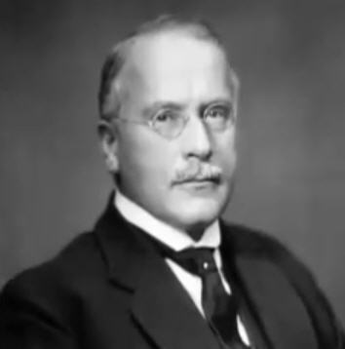
Carl Gustav Jung
Psychology of Sleep and Dreaming
Dr. Alexander Randall 5th

Slide 2
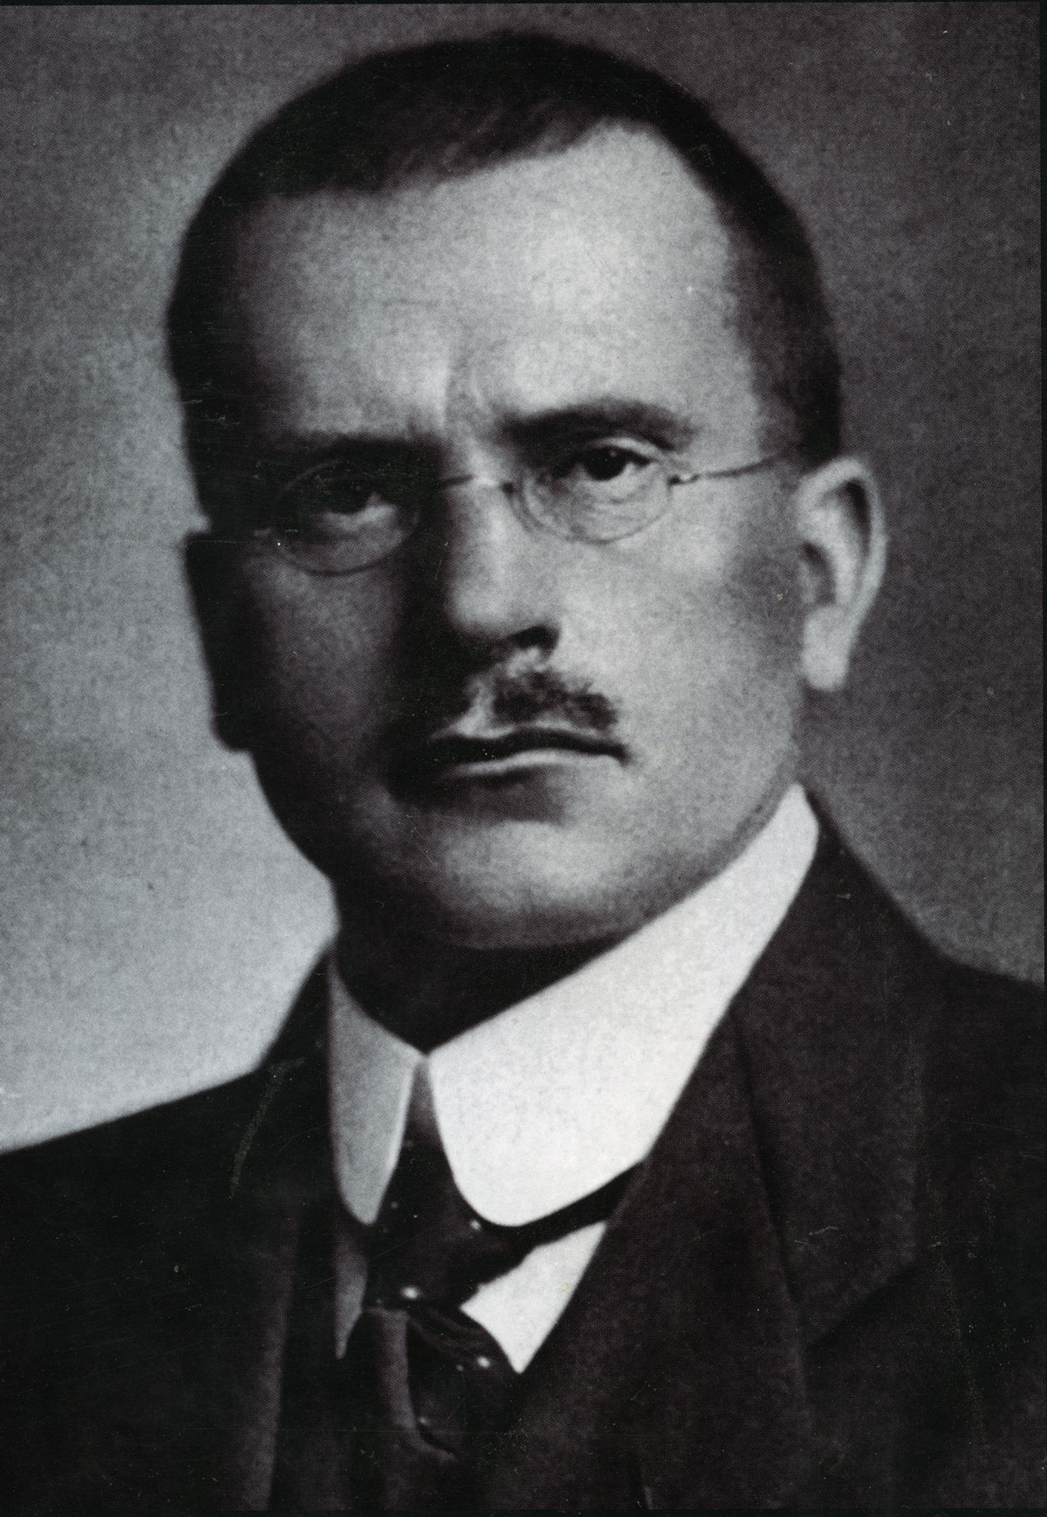
C.G. Jung
Contemporary of Freud
Slightly Younger
One of the Disciples
Broke with Freud over issues of doctrine
Freud too engaged in
Struggles of ego,
Fighting with Superego
Base desires
Sex
Repression

Slide 3
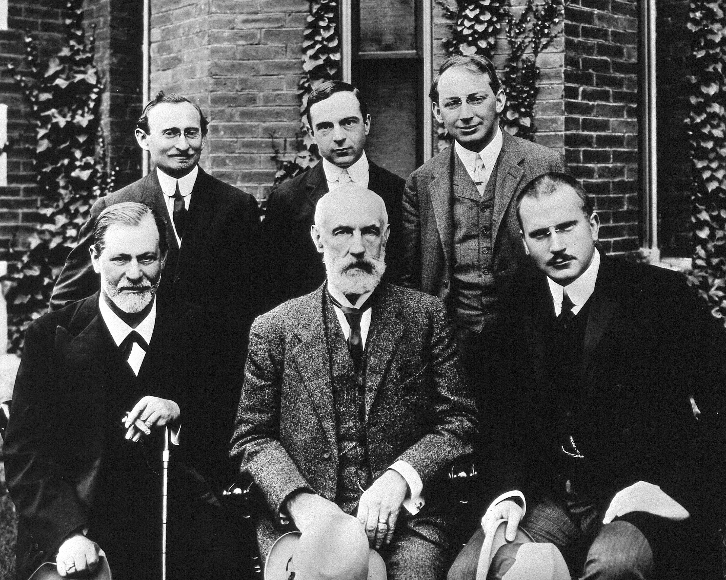

Slide 4
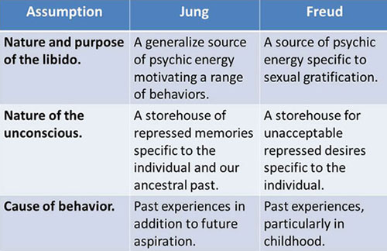
Jung broke with Freud:

Slide 5
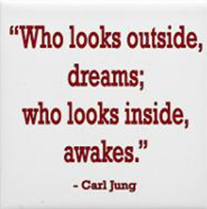
C.G. JunG
So much about the mind was left out of Freud’s ideas.
Jung accepts Ego and Superego, Id and repressed desires
BUT he notices:
Themes
Mythological characters
Culture
Discovered “Collective Unconscious”

Slide 6
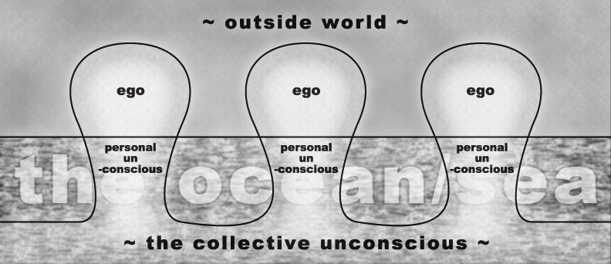

Slide 7
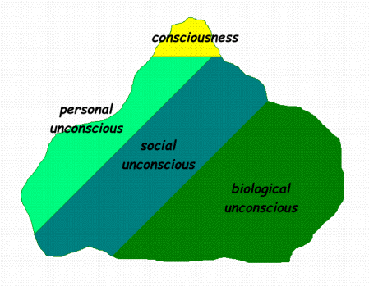

Slide 8
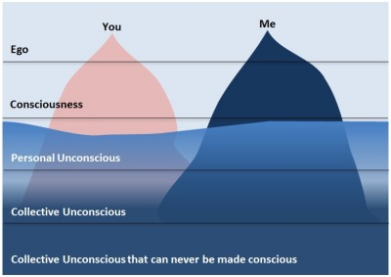

Slide 9
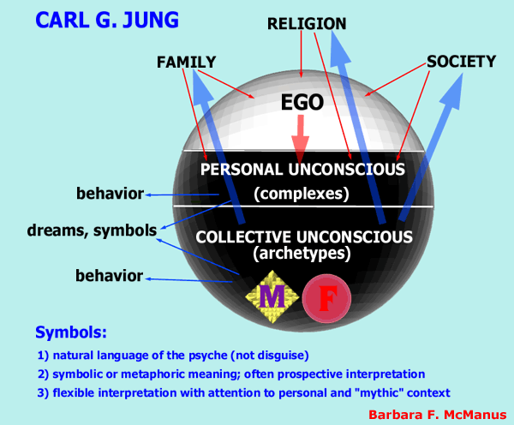

Slide 10
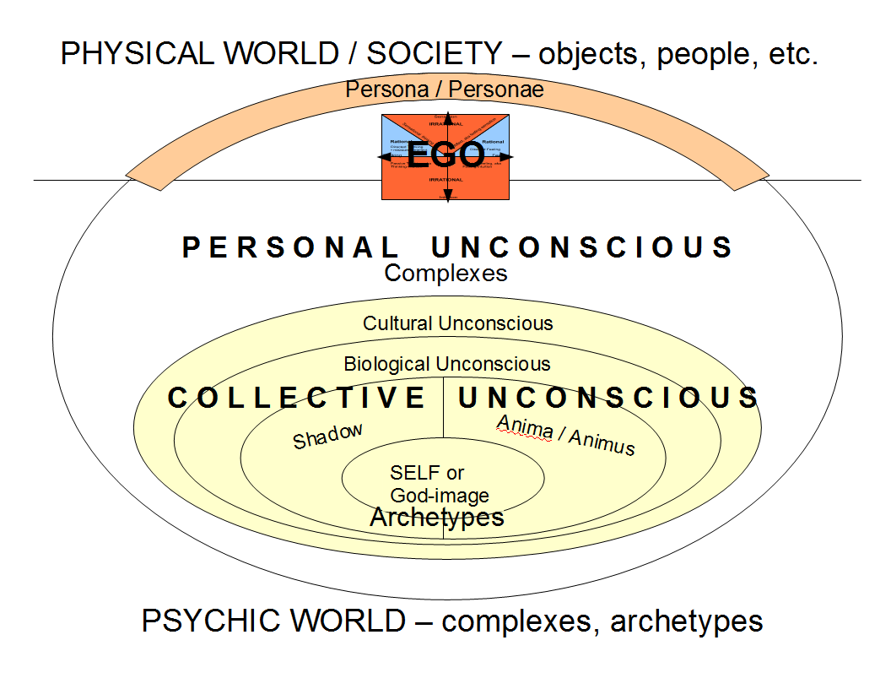

Slide 11
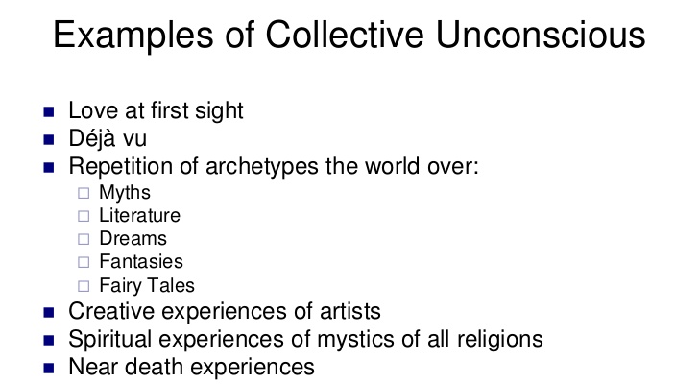

Slide 12
The Archetypes
Jung described archetypal events:
birth, death, separation from parents, initiation, marriage, the union of opposites;

Slide 13
The Archetypes
archetypal figures:
great mother, father, child, devil, god, wise old man, wise old woman, the trickster, the hero;

Slide 14
The Archetypes
archetypal motifs:
the apocalypse,
the deluge,
the creation.

Slide 15
The Archetypes
The number of archetypes is limitless, there are a few particularly notable, recurring archetypal images,
the shadow,
the wise old man,
the child,
the mother ..

Slide 16
The Archetypes
The shadow is a representation of the personal unconscious as a whole and usually embodies the compensating values to those held by the conscious personality.
Thus, the shadow often represents one's dark side, those aspects of oneself that exist, but which one does not acknowledge or with which one does not identify.

Slide 17
The Archetypes
The anima archetype appears in men and is his primordial image of woman. It represents the man's biological expectation of women, but also is a symbol of a man's feminine possibilities, his contrasexual tendencies.
The animus archetype is the analogous image of the masculine that occurs in women.

Slide 18
Archetypes seek actualization within the context of an individual's environment and determine the degree of individuation.
The archetypal plan unfolds through a programmed sequence which Jung called the stages of life.
Each stage of life is mediated through a new set of archetypal imperatives which seek fulfillment in action.
These may include being parented, initiation, courtship, marriage and preparation for death

Slide 19
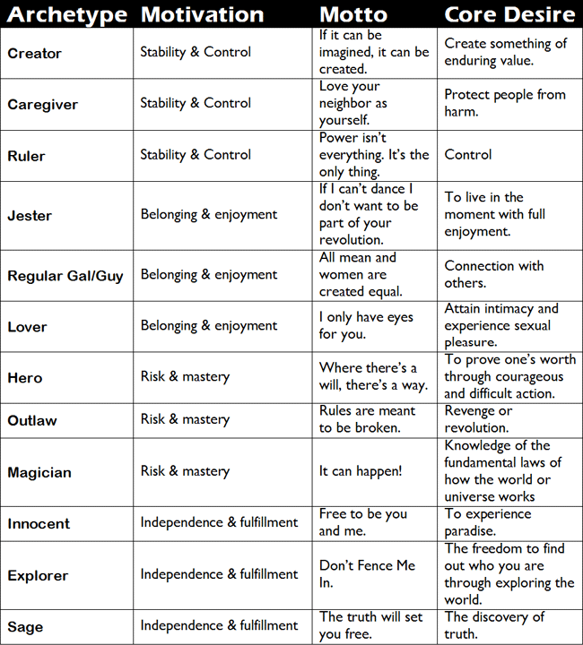
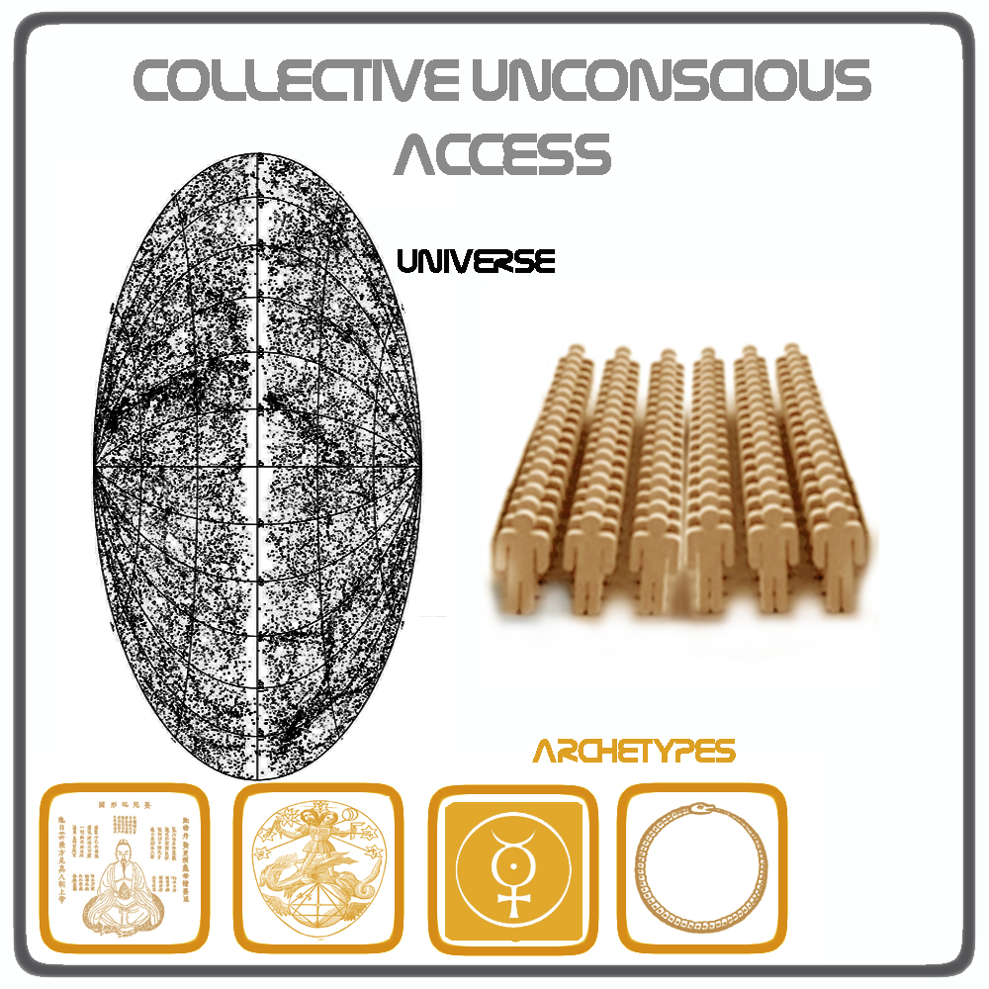

Slide 20
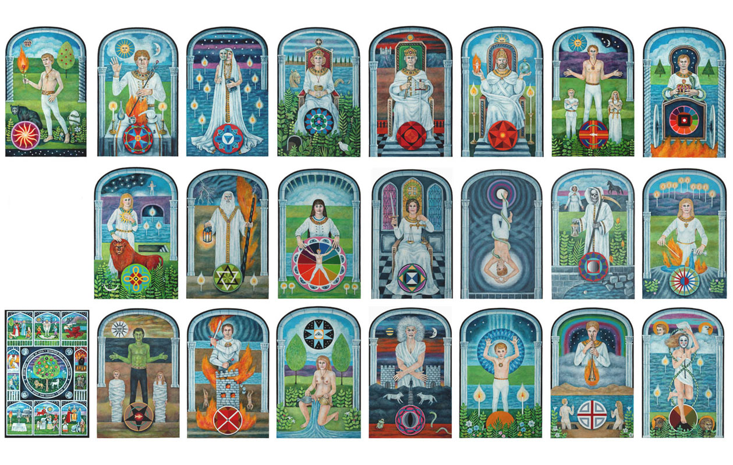

Slide 21
So he investigates:
Alchemy
Astrology
Tarot
Ancient Mythology
Religion
Any topic that helps him get insight into the mythology and myth making – a window on the collective unconscious.

Slide 22
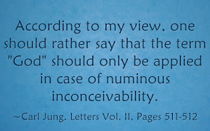
Transcendent
Numinous

Slide 23
Numinous /ˈnjuːmᵻnəs/ is an English adjective, derived from the Latin numen, meaning "arousing spiritual or religious emotion; mysterious or awe-inspiring".“
From the Latin numen, that is, (in ancient Roman religion) a "deity or spirit presiding over a thing or space".Meaning "denoting or relating to a numen", it describes the power or presence or realisation of a divinity.
According to German theologian Rudolf Otto, the numinous experience has the mysterium tremendum,
the tendency to invoke fear and trembling,
a quality of fascinans, the tendency to attract, fascinate and compel

Slide 24
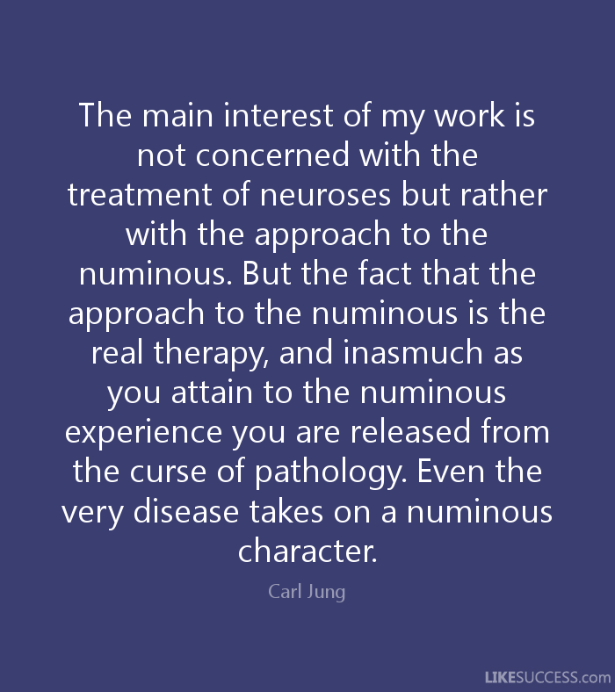
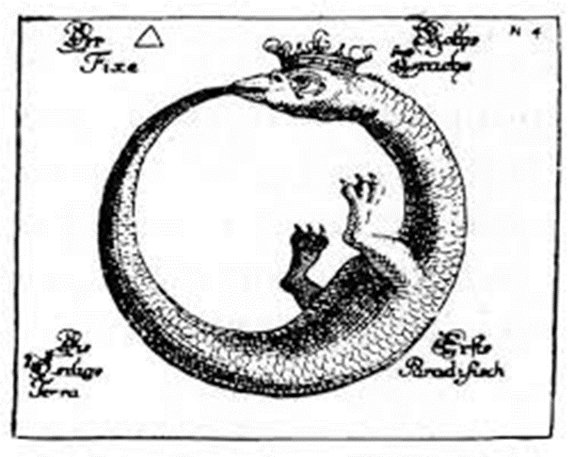
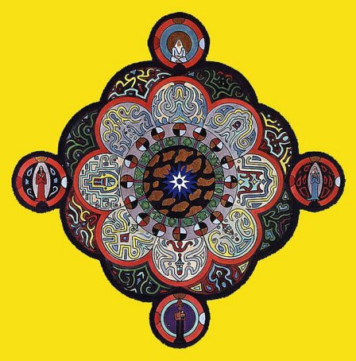

Slide 25
The images in dreams have at their roots the myths and folklore of our culture
You can only dream with the images and metaphors that are in your personal life, your cultural life and the collective unconscious

Slide 26
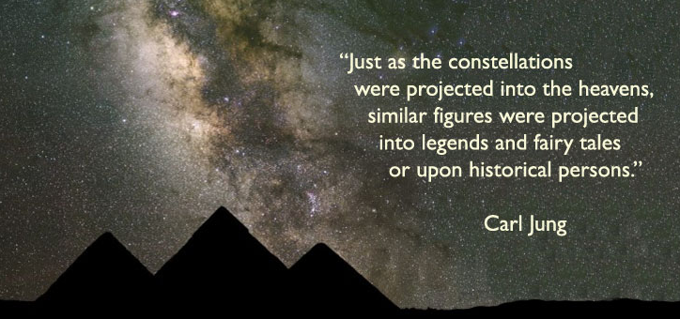

Slide 27
